Slide 1
Technical Task Definition of a Data Science Product
Berthold Aghokeng
Shawaiz Shah
Teodor Chiaburu

Slide 2
Table of contents:
Data Products
Role of a Data Scientist
Technical Tasks
Conclusion

Slide 3
1. Data Products 1. Definition
“… a product that facilitates an end goal through the use of data”
Dhanurjay Patil, Chief Data Scientist of the US Office of Science and Technology Policy
“… a product whose primary objective is to facilitate an end goal through the use of data”
Too broad?

Slide 4


1. Data Products 2. Examples (Yahoo Mail)

Slide 5



1. Data Products 2. Examples (Instagram)

Slide 6
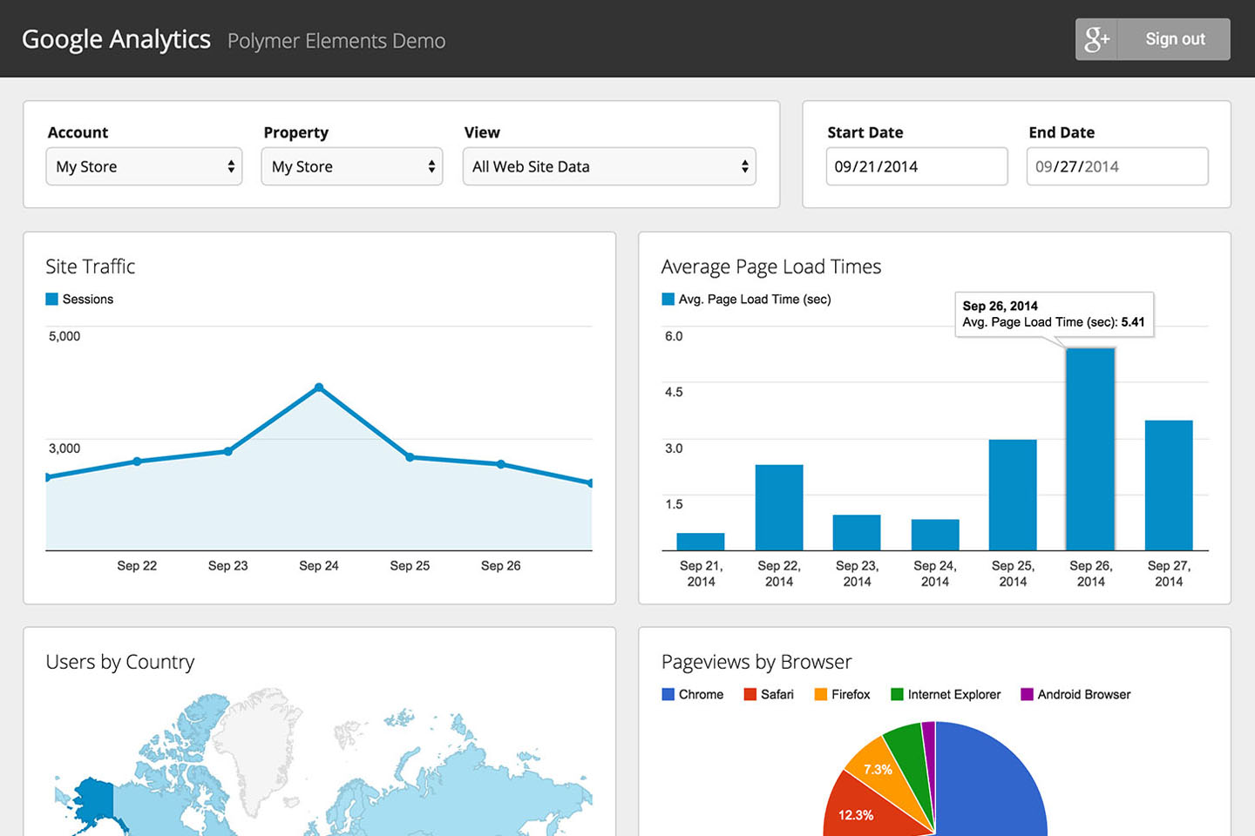
1. Data Products 2. Examples (Google Analytics)

Slide 7
1. Data Products 3. Types
Automated Decision Making
Decision Support
Algorithms
Derived Data
Raw Data
Complexity
Program Workload
User Workload

Slide 8
1. Data Products 3. Types (Raw Data)
collect and make data available as it is
most of the work is done by the user* (usually including preprocessing steps such as data cleansing)
example: website carrying out an online survey
*Note: the term ‚user‘ denotes here the developer making use of the data collected from the survey

Slide 9
1. Data Products 3. Types (Derived Data)
the user is provided with (partially) preprocessed data
example: a program that carries out customer segmentation or adds the likelihood of buying a specific product (new feature in the data set)

Slide 10
1. Data Products 3. Types (Algorithms)
given some input rom the user, the program runs it through an algorithm and returns information or insights
example: Google‘s search engine

Slide 11
1. Data Products 3. Types (Decision Support)
the program provides information to the user to help them in the process of decision-making; however, the decision is still made by the user
example: Google Analytics

Slide 12
1. Data Products 3.Types (ADM)
the algorithm does all the work and presents the user with the final output
example: self-driving cars

Slide 13
2. Role of a Data Scientist
Why does a company need a data scientist?
Develop
Train
Deploy
ML model for sustainable solving of a problem

Slide 14
3. Technical Tasks 1. Tactical Approaches
Team organization:
Data scientist team ->thinks
Data engineering team -> builds

Slide 15
3. Technical Tasks 1. Tactical Approaches
Choice of a business model (4 possibilities from last week's class):
Data scientist decides to build their own ML model
Pay for an existing solution
Rent instead of paying
Sign a partnership with a supplier when needed

Slide 16
3. Technical Tasks 1. Tactical Approaches
Choice of tools for execution:
Scrum
Jira
V2MOM
...

Slide 17
3. Technical Tasks 2. Align tactical execution plans with strategical goals

Slide 18
3. Technical Tasks 3. Optimization of execution

Slide 19
4. Conclusion

Slide 20
Resources
Machine Learning Yearning – Technical Strategy for AI Engineers In the Era of Deep Learning, Andrew Ng
https://towardsdatascience.com/designing-data-products-b6b93edf3d23
https://medium.com/upwork-datascience/managing-data-science-with-v2mom-scrum-and-cross-functional-squads-655b08cf828b
https://towardsdatascience.com/data-science-agile-cycles-my-method-for-managing-data-science-projects-in-the-hi-tech-industry-b289e8a72818

